Slide 1

Asynchronous Programming and Promises
Fetch API, Promises, async/await
SoftUni Team
Technical Trainers
Software University
https://softuni.bg

Slide 2
Table of Contents
AJAX
Asynchronous Programming
Promises Deep Dive
Async / Await

Slide 3
Have a Question?
sli.do #js-advanced

Slide 4
AJAX
A AX
Asynchronous JavaScript and XML

Slide 5
What is AJAX?
Asynchronous JavaScript And XML
Background loading of dynamic content/data
Load data from the Web server and render it
Two types of AJAX
Partial page rendering
Load HTML fragment + show it in a <div>
JSON service
Loads JSON object and displays it

Slide 6




AJAX: Workflow
1. HTTP request (initial page load)
2. HTTP response (HTML page)
AJAX request
UI Interaction
AJAX response (asynchronous)
AJAX handler
Returns data as JSON / HTML
Web Client
Web Server
Modify the page DOM

Slide 7
Using the XMLHttpRequest Object
AJAX request
AJAX response
Web Client
Web Server

Slide 8
XMLHttpRequest – Standard API for AJAX
<button id = "load">Load Repos</button>
<div id="res"></div>
let button = document.querySelector("#load");
button.addEventListener('click', function loadRepos() {
let url = 'https://api.github.com/users/testnakov/repos';
const httpRequest = new XMLHttpRequest();
httpRequest.addEventListener('readystatechange', function () {
if (httpRequest.readyState == 4 && httpRequest.status == 200) {
document.getElementById("res").textContent = httpRequest.responseText;
}
});
httpRequest.open("GET", url);
httpRequest.send();
});
Notes:
Check this slides code -> I think it can be optimized

Slide 9

Synchronous vs Asynchronous
Asynchronous Programming

Slide 10
Asynchronous Programming in JS
Not the same thing as concurrent or multi-threaded
There can be asynchronous code, but it is generally single-threaded
Structured using callback functions
In current versions of JS there are:
Callbacks
Promises
Async Functions

Slide 11
Asynchronous Programming
Runs several tasks (pieces of code) in parallel, at the same time
Synchronous
Asynchronous
Number of tasks
Number of tasks
1
1
20 seconds
20 seconds
2
2
7 seconds
7 seconds
3
3
10 seconds
10 seconds
4
4
8 seconds
8 seconds

Slide 12
Asynchronous Programming – Example
The following commands will be executed as follows:
console.log("Hello.");
setTimeout(function() {
console.log("Goodbye!");
}, 2000);
console.log("Hello again!");
// Hello.
// Hello again!
// Goodbye!

Slide 13
Callbacks
Function passed into another function as an argument
Then invoked inside the outer function to complete some kind of routine or action
function running() {
return "Running";
}
function category(run, type) {
console.log(run() + " " + type);
}
category(running, "sprint"); //Running sprint
Callback
function

Slide 14
Event Loop

Slide 15

Promises
Objects Holding Asynchronous Operations

Slide 16
What is a Promise?
A promise is an asynchronous action that may complete at some point and produce a value
States:
Pending - operation still running (unfinished)
Fulfilled - operation finished (the result is available)
Failed - operation failed (an error is present)
Promises use the Promise object
new Promise(executor);

Slide 17
Promise Flowchart
Promise
then
resolve
onFulfilled
return data
reject
onRejected
throw error

Slide 18
Promise.then() – Example
console.log('Before promise');
new Promise(function(resolve, reject) {
setTimeout(function() {
resolve('done');
}, 500);
})
.then(function(res) {
console.log('Then returned: ' + res);
});
// Before promise
Resolved after 500 ms
// After promise
// Then returned: done
console.log('After promise');

Slide 19
Promise.catch() – Example
console.log('Before promise');
new Promise(function (resolve, reject) {
setTimeout(function () {
reject('fail');
}, 500);
})
.then (function (result) { console.log(result); })
.catch (function(error) { console.log(error); });
Rejected after 500 ms
console.log('After promise');

Slide 20
Promise Methods
Promise.reject(reason)
Returns an object that is rejected with the given reason
Promise.resolve(value)
Returns an object that is resolved with the given value
Promise.all(iterable)
Returns a promise
Fulfills when all of the promises have fulfilled
Rejects as soon as one of them rejects

Slide 21
Promise Methods (2)
Promise.allSettled(iterable)
Wait until all promises have settled
Promise.race(iterable)
Returns a promise that fulfills or rejects as soon as one of the promises in an iterable is settled
Promise.prototype.finally()
The handler is called when the promise is settled

Slide 22
What is Fetch?
The fetch() method allows making network requests
It is similar to XMLHttpRequest (XHR). The main difference is that the Fetch API:
Uses Promises
Enables a simpler and cleaner API
Makes code more readable and maintainable
fetch('./api/some.json')
.then(function(response) {…})
.catch(function(err) {…})

Slide 23
Basic Fetch Request
The response of a fetch() request is a Stream object
The reading of the stream happens asynchronously
When the json() method is called, a Promise is returned
The response status is checked (should be 200) before parsing the response as JSON
if (response.status !== 200) {
// handle error
}
response.json()
.then(function(data) { console.log(data)})

Slide 24
GET Request
Fetch API uses the GET method so that a direct call would be like this
fetch('https://api.github.com/users/testnakov/repos')
.then((response) => response.json())
.then((data) => console.log (data))
.catch((error) => console.error(error))

Slide 25
POST Request
To make a POST request, we can set the method and body parameters in the fetch() options
fetch('/url', {
method: 'post',
headers: { 'Content-type': 'application/json' },
body: JSON.stringify(data),
})

Slide 26
Body Methods
clone() create a clone of the response
json() resolves the promise with JSON
redirect() create new promise but with different URL
text() resolves the promise with string
arrayBuffer() resolve body with ArrayBuffer
blob() resolve body with Blob (file, image, etc.)
formData() resolve body with FormData

Slide 27
Response Types
basic - normal, same origin response
cors - response was received from a valid cross-origin request
error - error network
opaque - Response for "no-cors" request to cross-origin resource
opaqueredirect - the fetch request was made with redirect: "manual"

Slide 28
Chaining Promises
When working with a JSON API, you can:
Define the status and JSON parsing in separate functions
The functions return promises which can be chained
fetch('users.json')
.then(status)
.then(json)
.then(function(data) {…})
.catch(function(error) {…});

Slide 29
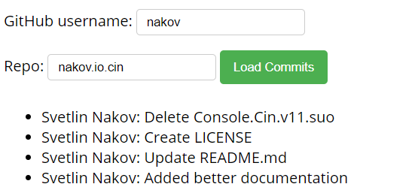
Problem: Load GitHub Commits
GitHub username:
<input type="text" id="username" value="nakov" /> <br>
Repo: <input type="text" id="repo" value="nakov.io.cin" />
<button onclick="loadCommits()">Load Commits</button>
<ul id="commits"></ul>
<script>
function loadCommits() {
// Use Fetch API
}
</script>

Slide 30
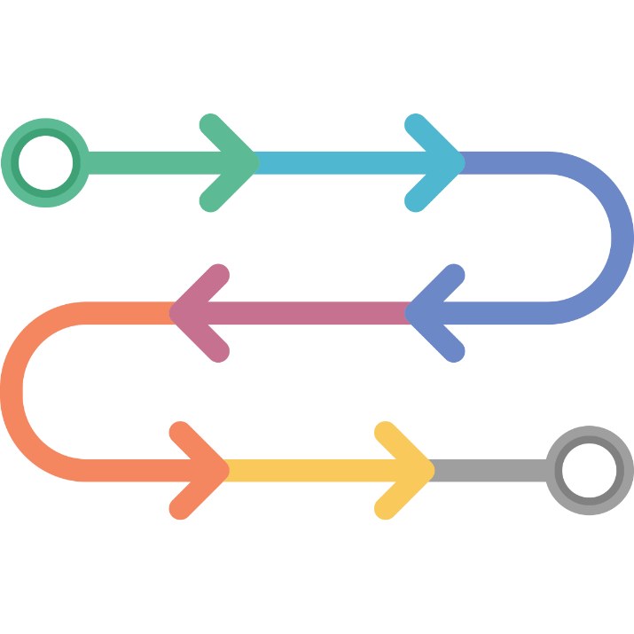
Async / Await
Simplified Promises

Slide 31
Async Functions
Returns a promise, that can await other promises in a way that looks synchronous
Operate asynchronously via the event loop
Contains an await expression that:
Is only valid inside async functions
Pauses the execution of that function
Waits for the Promise's resolution

Slide 32
Async Functions (2)
function resolveAfter2Seconds() {
return new Promise(resolve => {
setTimeout(() => {
resolve('resolved');
}, 2000);
});
}
Expected output:
// calling
// resolved
async function asyncCall() {
console.log('calling');
let result = await resolveAfter2Seconds();
console.log(result);
}

Slide 33
Async Functions (3)
Do not confuse await with Promise.then()
await is always used for a single promise
To await two or more promises in parallel, use Promise.all()
If a promise resolves normally, then await promise returns the result
In case of a rejection, it throws an error

Slide 34
Async/Await vs Promise.then
Promise.then
Async/Await
function logFetch(url) {
return fetch(url)
.then(response => {
return response.text()
})
.then(text => {
console.log(text);
})
.catch(err => {
console.error(err);
});
}
async function logFetch(url) {
try {
const response =
await fetch(url);
console.log(
await response.text()
);
}
catch (err) {
console.log(err);
}
}

Slide 35
Error Handling
async function f() {
try {
let response = await fetch();
let user = await response.json();
} catch (err) {
// catches errors both in fetch andresponse.json
alert(err);
}}
async function f() {
let response = await fetch();
} // f() becomes a rejected promise
f().catch(alert);

Slide 36
Sequential Execution
To execute different promise methods one by one, use Async /Await
function execute(x,sec) {
return new Promise(resolve => {
console.log('Start: ' + x);
setTimeout(() => {
console.log('End: ' + x);
resolve(x);
}, sec *1000); }); }
// Start: 1
// End: 1
// Start: 2
// End: 2
// Start: 3
// End: 3
// 6
async function serialFlow() {
let result1 = await execute(1, 1);
let result2 = await execute(2, 2);
let result3 = await execute(3, 3);
let finalResult = result1 + result2 + result3;
console.log(finalResult);
}

Slide 37
Concurrent Execution
async function parallelFlow() {
let result1 = execute(1,1);
let result2 = execute(2,2);
let result3 = execute(3,3);
let finalResult = await result1 + await result2 +
await result3;
console.log(finalResult);
}
// Expected output:
// Start: 1
// Start: 2
// Start: 3
// End: 1
// End: 2
// End: 3
// 6

Slide 38

Summary
…
…
…
Asynchronous programming
Runs several tasks in parallel, at the same time
Promises hold operations
Can be resolved or rejected
Async functions contain an await expression
Yields the execution
Waits for the Promise's resolution

Slide 39
Questions?
Notes:
39

Slide 40













SoftUni Diamond Partners

Slide 41


Educational Partners

Slide 42
Trainings @ Software University (SoftUni)
Software University – High-Quality Education, Profession and Job for Software Developers
softuni.bg, softuni.org
Software University Foundation
softuni.foundation
Software University @ Facebook
facebook.com/SoftwareUniversity
Software University Forums
forum.softuni.bg
Notes:
42

Slide 43

License
This course (slides, examples, demos, exercises, homework, documents, videos and other assets) is copyrighted content
Unauthorized copy, reproduction or use is illegal
© SoftUni – https://softuni.org
© Software University – https://softuni.bg
Notes:
43

